Slide 1



Digital Portfolio
STUDENT NAME: AMUDHAMOZHI B
REGISTER NO :2428M0062
EMAIL ID :24bsds105amudhamozhib@skacas.ac.in
DEPARTMENT : BSC DATA SCIENCE
COLLEGE : SRI KRISHNA ADITHYA COLLEGE OF ARTS AND SCIENCE

Slide 2
PROJECT TITLE
DIGITAL
PORTFOLIO

Slide 3

AGENDA
1 .Project Overview
2. End Users
3. Tools and Technologies
4. Portfolio design and Layout
5. Features and Functionality
6. Results and Screenshots
7. Conclusion
8. Problem Statement
9. Github Link

Slide 4

PROBLEM STATEMENT
The purpose of this portfolio is to showcase my skills, experiences, and achievements in a professional, organized, and visually appealing manner. Many individuals struggle to effectively present their work and capabilities to potential employers, clients, or collaborators. A well-structured digital portfolio addresses this challenge by:
•Highlighting key projects and accomplishments.
•Demonstrating technical and creative skills through practical examples.
•Providing a centralized, accessible platform for professional growth and personal branding.
This portfolio aims to solve the problem of communicating expertise and career readiness in a competitive market, ensuring that my profile stands out and leaves a strong impression on the audience.

Slide 5

PROJECT OVERVIEW
This portfolio website was developed to serve as a professional platform showcasing my academic background, technical expertise, and personal projects. The goal is to create a centralized hub where potential employers, collaborators, or clients can easily explore my work, skills, and accomplishments. The website highlights:
•About Me - an introduction to who I am, my interests, and career goals.
•Skills - a demonstration of technical and soft skills relevant to my field.
•Projects - selected works and case studies that reflect my abilities and problem-solving approach. •Contact - an accessible way for visitors to connect with me.
By combining clean design with organized content, the portfolio provides a professional digital identity that represents both creativity and technical proficiency. off

Slide 6

WHO ARE THE END USERS?
1. Potential Employers / Recruiters
1. They use the portfolio to evaluate your skills, projects, and suitability for a job role.
2. They expect clarity, professionalism, and evidence of your capabilities.
2. Clients (if you’re freelancing or offering services)
1. They look for examples of past work, creativity, and trustworthiness before hiring you.
3. Peers & Collaborators
1. Fellow students, colleagues, or professionals may use your portfolio to learn more about your expertise and potentially collaborate on projects.
4. Academic Mentors / Professors (if it’s a student portfolio)
1. They might use it to assess your learning progress, academic projects, or readiness for internships and research opportunities.
5. General Audience / Network
1. Anyone who comes across your portfolio (via LinkedIn, GitHub, or personal sharing) who wants to know more about you.

Slide 7

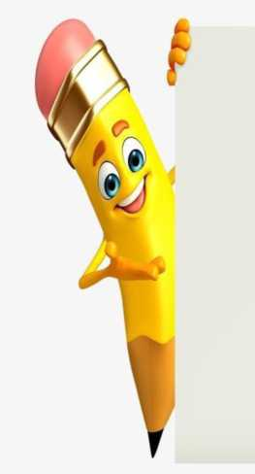
TOOLS AND TECHNIQUES
1. Frontend Development
1. HTML5, CSS3, JavaScript - for creating the structure, design, and interactivity of the website.
2. Responsive Design Techniques - ensuring the portfolio works seamlessly across devices (desktop, tablet, mobile).
2. Design and Styling
1. CSS Frameworks (Bootstrap / Tailwind CSS) - to speed up layout and styling with modern UI components.
2. Custom CSS Animations - to add smooth transitions and interactivity.
3. Version Control
1. Git & GitHub - for code management, collaboration, and hosting.
4. Deployment
1. GitHub Pages / Netlify / Vercel - to make the portfolio accessible online.
5. Techniques Used
1. User-Centered Design - focusing on clarity, readability, and ease of navigation for recruiters and clients.
2. Modular Code Structure - separating concerns (HTML for structure, CSS for design, JS for logic).
3. Performance Optimization - compressing images, minimizing code for faster load times.

Slide 8

POTFOLIO DESIGN AND LAYOUT
The portfolio is designed with a clean, user-friendly layout that prioritizes readability and easy navigation section-based structure, allowing visitors to quickly access relevant information.
e design follows a
Key Design Elements:
• Homepage / Landing Section
• A brief introduction with name, role, and a visual identity (e.g., profile image or banner).
• Clear navigation to other sections.
• About Me Section
• A concise personal statement highlighting background, interests, and career goals.
• Skills Section
• A visual representation of technical and soft skills using lists, icons, or progress indicators.
• Projects Section
• Showcase of selected works with descriptions, technologies used, and outcomes.
• Organized in cards or grid layout for clarity.
• Contact Section
• Contact details and links (email, LinkedIn, GitHub, etc.).
• Possibly a contact form for direct communication.
Layout Characteristics:
• Responsive Design - adapts to mobile, tablet, and desktop devices.
• Consistent Theme - unified color scheme, typography, and spacing.
• Minimalist Approach - avoids clutter while keeping the focus on content.
• Interactive Elements - hover effects, buttons, and animations for modern appea

Slide 9

FEATURES AND FUNCNALITY
1. Homepage / Landing Section
1. Provides a professional introduction with name, role, and branding elements.
2. Quick navigation menu for accessing different sections.
2. About Me Section
1. Showcases personal background, academic qualifications, and career goals.
2. Presents a concise overview of who I am and what I aim to achieve.
3. Skills Section
1. Displays technical and soft skills in an organized format.
2. May include icons, charts, or progress bars for better visualization.
4. Projects Section
1. Highlights selected projects with descriptions, objectives, tools used, and outcomes.
2. Provides links (e.g., GitHub repositories or live demos) where applicable.
5. Contact Section
1. Lists email, social media, and professional links (LinkedIn, GitHub, etc.).
2. May include a contact form for direct communication.
6. Responsive Design
1. Ensures compatibility across devices (desktop, tablet, mobile).
7. User-Friendly Navigation
1. Clear menu and smooth scrolling between sections.
8. Visual Enhancements
1. Animations, hover effects, and styled buttons to improve interactivity and appeal

Slide 10

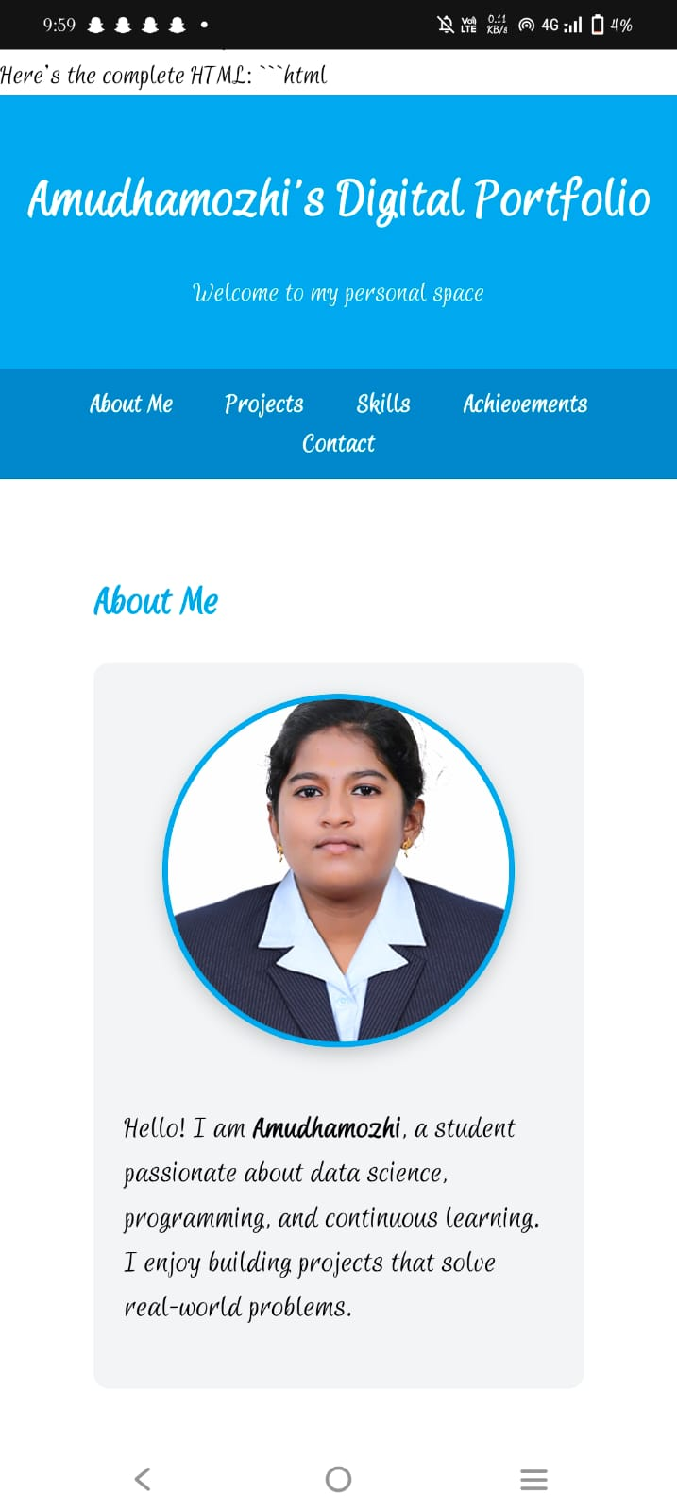
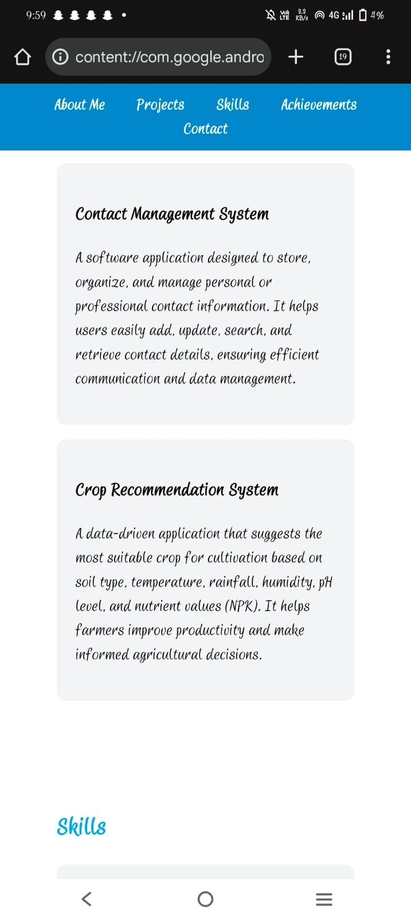

RESULTS AND SCREENSHOTS
10

Slide 11
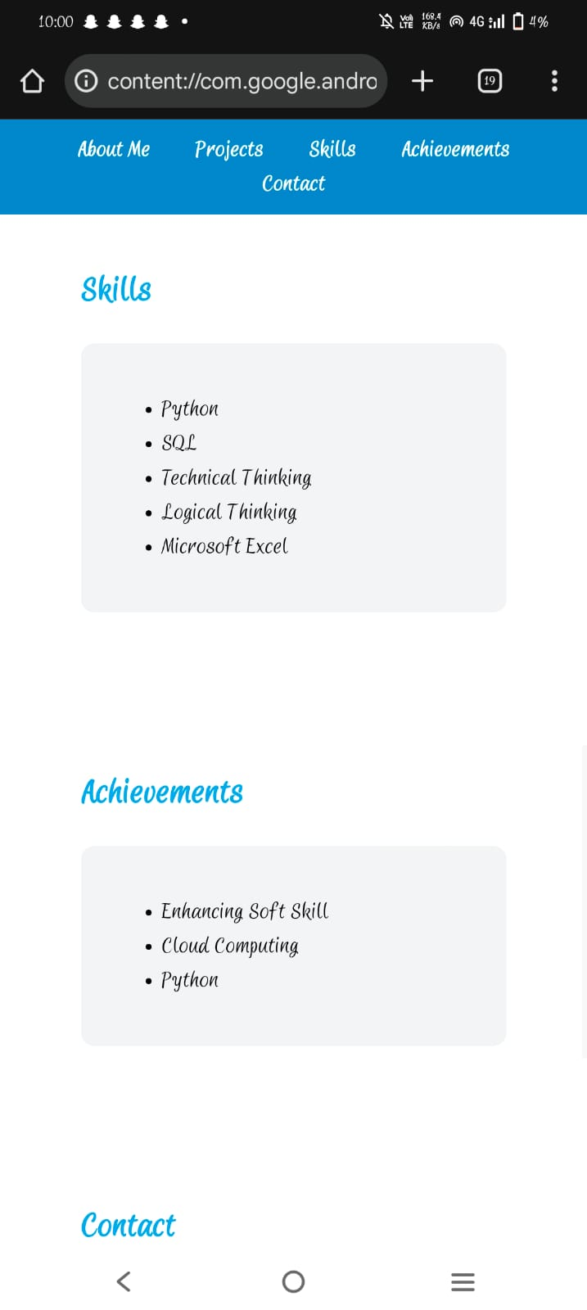
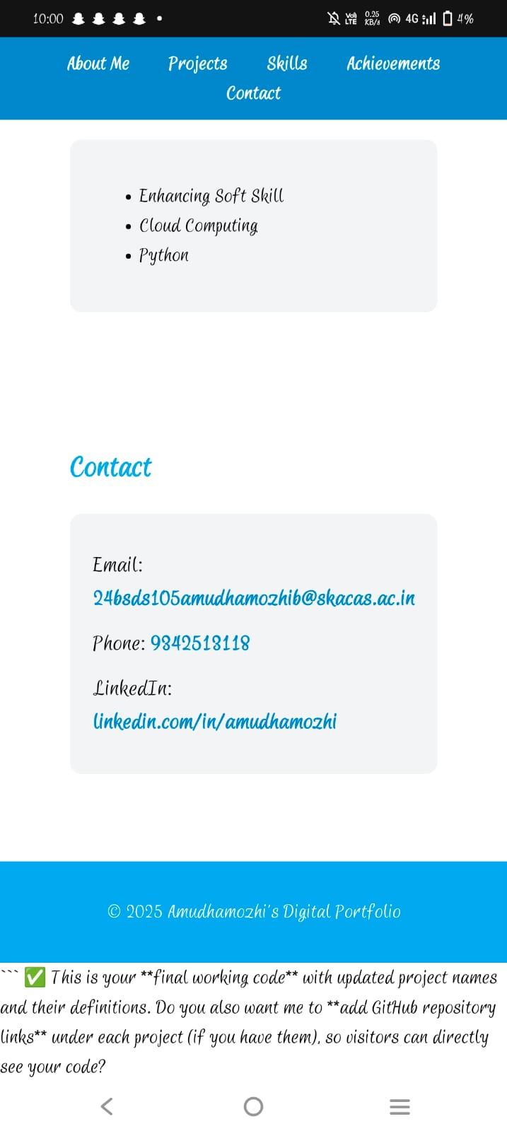

RESULTS AND SCREENSHOTS
• Digital Poitfolio
© File G/Users/Admin/AppData/Local/reinp/356f5375-7978-42d8-8b4f-b3ab3da684b4j)rogramiz-html-css%20(4).zip.4b4/programiz-htn>l-css/index.html
Achievements
Completed Certification in Python Programming
Completed Certification in 3D Animation
Completed Certification in Tally
Completed Certification in Microsoft Excel
Completed Certification in Cloud Computing
Secured 2nd Rank in 1st Year with First Class with Distinction
Contact
Email: 24bsds150srinithir@skacas.ac
Phone: 9865442829
Linkedln: linkedin.com/in/srinithi-r

Slide 12

CONCLUSION
This portfolio website successfully serves as a professional platform to present my skills, experiences, and achievements in an organized and visually appealing manner. By integrating a clean design, responsive
layout, and user-friendly navigation, it ensures accessibility across devices and provides a positive user
experience.
The project not only demonstrates my technical expertise in web development but also highlights my ability
to apply design principles, problem-solving techniques, and creativity to build a practical solution.
Overall, the portfolio achieves its objective of creating a personal brand identity while offering potential
employers, clients, and collaborators a clear insight into my capabilities and career aspirations. It stands as a
foundation that can be expanded and updated as I grow professionally and acquire new skills.

